Slide 1

Project Review I
College Name: S. B. Jain Institute of Technology, Management and Research, Nagpur
Department Name: Emerging Technologies
Project Title: A Dual Encryption-Based Framework for Medical Images
Group Members: Mr. Rohit Khadse (Team Leader), Ms. Khushi Ghatode,
Ms. Isha Bairam, Ms. Shrushti Adkane
Guide Name: Ms. Harshika Dehariya

Slide 2
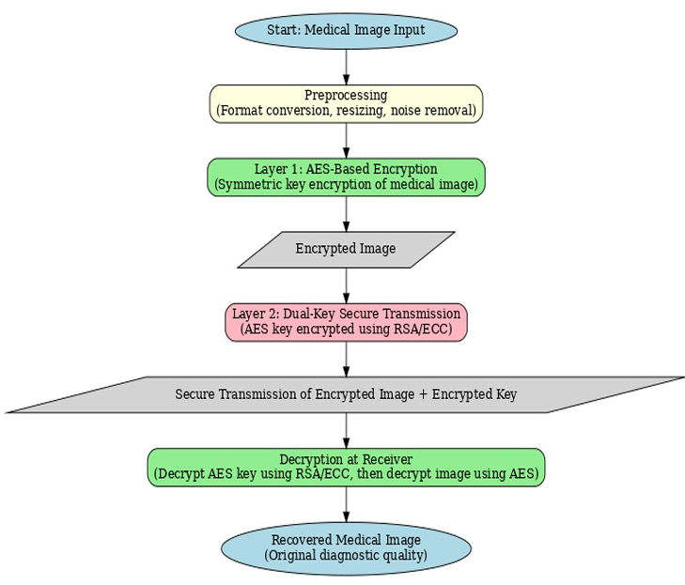
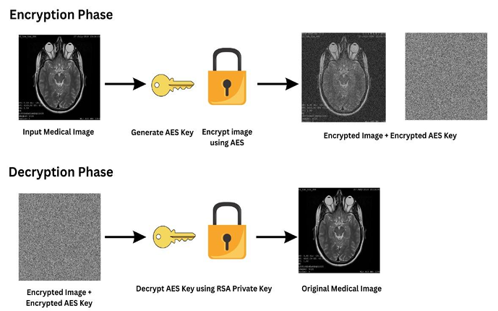
Methodology
This securely protects medical images by first encrypting them with AES and then encrypting the AES key using RSA for safe transmission. At the receiver end, the AES key is decrypted and used to fully recover the original medical image without loss of diagnostic quality.

Slide 3
Future Scope
Background Work
Previous studies mainly used single-layer AES or RSA, which were either fast but weak in key management or secure but slow for large medical images. Hybrid models were attempted, but many lacked pixel-level permutation or proper validation using medical-grade datasets.
Future Work:
The system can be extended by adding lightweight chaotic encryption, QR-code–based secure key packaging, and OTP-verified access for real-time telemedicine environments. Future versions may also integrate blockchain-based audit trails and cloud deployment for secure, large-scale medical image sharing.

